Slide 1
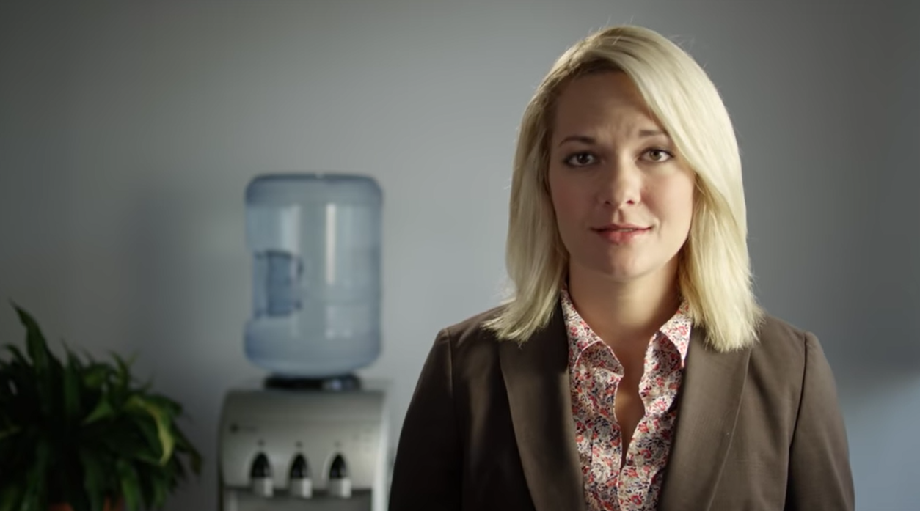

Slide 2
Announcements
Our TAs are Bryce Cindrich and Dallin Fairbanks
Reach them at redd201ta@gmail.com
Their schedule is in the TA calendar.
All of this is at Learning Suite – Content – TA Help
Office Hours
Watch for an announcement by email later today and find it on Learning Suite – Content – Office Hours

Slide 3
Bandwidth, Networks, Security, Privacy
IS 201
Prof. Brandt Redd
Notes:
http://gaskination.com/ticker
http://www.worldometers.info/
http://www.internetlivestats.com/
http://wwwnui.akamai.com/gnet/globe/index.html

Slide 4
Network Speed
A misnomer: all electronic networks operate at the speed of light.
Latency
The amount of time it takes data to get through all of the routers between source and destination.
The sum of all the propagation delays.
Bandwidth
How much data can get through during an interval of time.

Slide 5
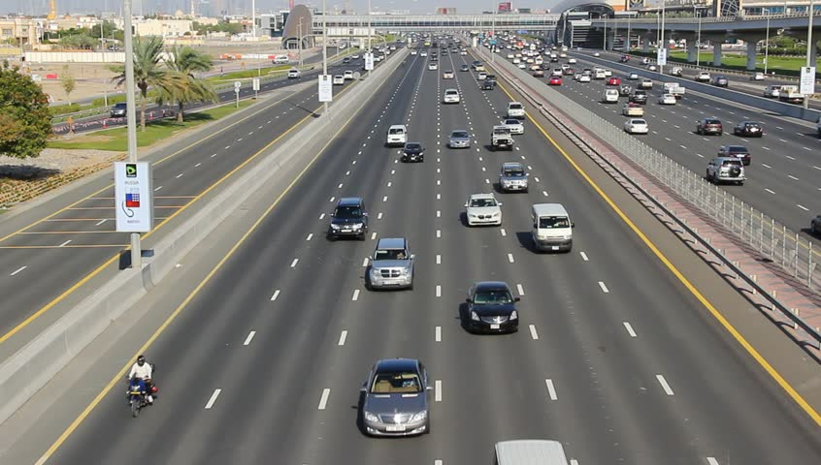

Slide 6
Demo
Internet Speed Test

Slide 7
Bandwidth Demand (without data compression)
HD Television
1920 × 1080 pixels × 24 bits per pixel × 30 frames-per-second = 1,492,992,000 bps approx. 1.5 Gbps (using 1000s) or 1.4 Gbps (using 1024s)
CD Audio
44,100 samples/second × 16 bits/sample x 2 channels = 1,411,200 bps approx. 1.4 Mbps or 1.3 Mbps
A 700 MB CD can hold 69 minutes of uncompressed audio.

Slide 8
Data Compression
High quality MP3 Audio
320 Kbps vs. 1.3 Mbps: 75% Compression
High quality MP4 Video
6 Mbps vs. 1.4 Gbps: 99.5% compression

Slide 9
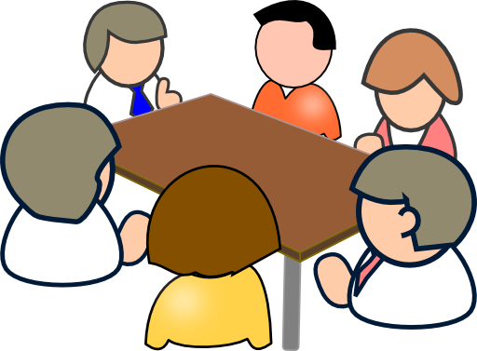
Networking Protocols: How to Communicate

Slide 10
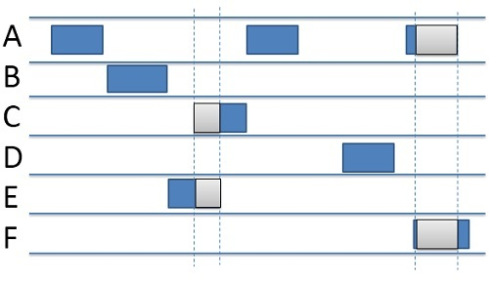
Random Aloha: Packet networks

Slide 11
CSMA/CD: Ethernet
MA = Multiple Access
Approximately 18% usable capacity
CSMA = Carrier Sense Multiple Access
Approximately 35% usable capacity
CSMA/CD = Carrier Sense Multiple Access with Collision Detection
Approximately 40% usable capacity

Slide 12
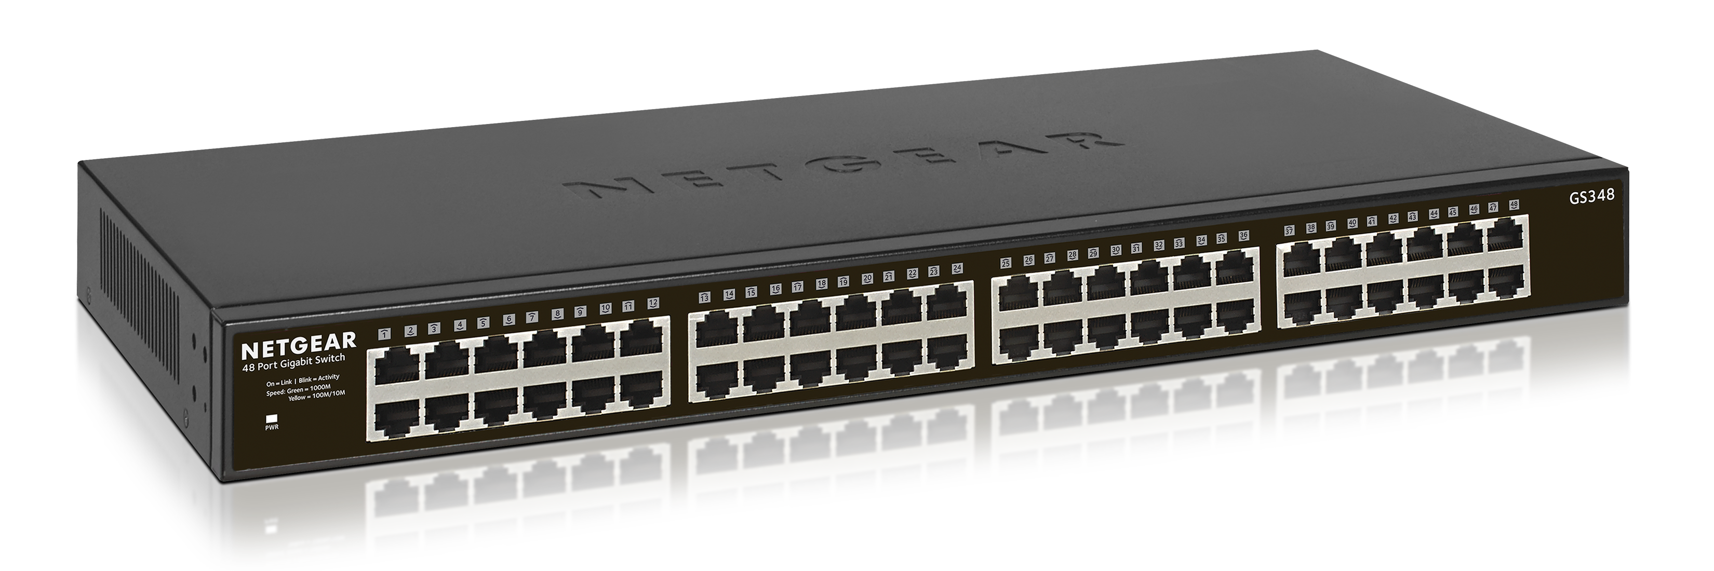
Hub vs. Switch
Hub
Switch
Usable Capacity for 100baseT (100 Mbps):
40% or 40 Mbps
Single Duplex
Usable Capacity for 100baseT (100 Mbps):
200% of each port. With 5 ports: 1000Mbps
Full Duplex

Slide 13
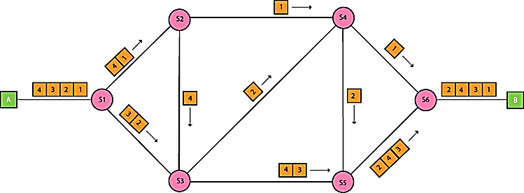
Packet Switching
Data are divided into packets and sent across a redundant network

Slide 14
Demo
Command-line: ipconfig
Command-line: nslookup

Slide 15
IP = Internet Protocol
IPv4 Address: 10.23.48.2
Subnet Mask: 255.240.0.0
IP Address Decimal | 10 | 23 | 48 | 2
Subnet Mask Dec | 255 | 240 | 0 | 0
IP Address Binary | 00001010 | 00010111 | 00110000 | 00000010
Subnet Mask Binary | 11111111 | 11110000 | 00000000 | 00000000
Network Address | 00001010 | 00010000 | 00000000 | 00000000
Device Address | 00000000 | 00000111 | 00110000 | 00000010
Address has 32 bits = 4,294,967,296 possible addresses?
Approximately 50 billion devices actually connected to the internet
How is this possible? Network Address Translation (NAT)

Slide 16

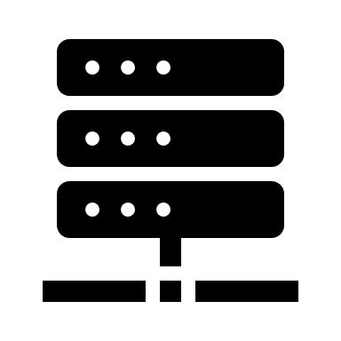
NAT = Network Address Translation
The Internet
LAN
Router:
Public IP Address: 136.36.111.12
16-bit port number = 65,536 ports
Port number: 39,742
Private IP Address: 10.23.48.2
Port number: 1,241

Slide 17
Demo
Website: https://whatismypublicip.com/

Slide 18
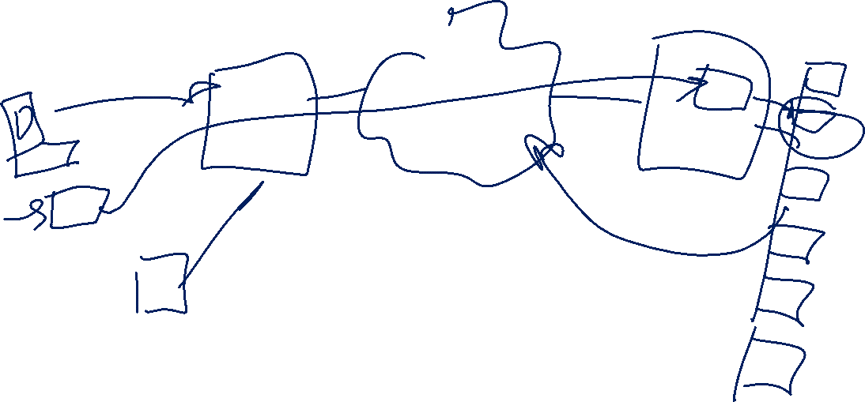
VPNs Virtual Private Networks

Slide 19
IPv4 vs IPv6
IPv4 | IPv6
32-bit addresses | 128-bit addresses
Up to 4,294,967,296 addresses | 3.4 x 10³⁸ Addresses
Variable subnet mask | 64 bits for network address 64 for device address

Slide 20
Protocols
Protocol | Description | Port | Sits on
Internet Protocol (IP) | Base of all internet communication | n/a | None
UDP/IP (Universal Datagram Protocol | Best-Effort Delivery | n/a | IP
TCP/IP (Terminal Control Protocol) | Guaranteed Delivery | n/a | IP
HTTP (Hypertext Transfer Protocol) | The Web | 80, 443 | TCP/IP
SMTP (Simple Mail Transfer Protocol) | Email | 20 | TCP/IP
RTSP (Real-Time Streaming Protocol) | Video, Audio Streaming | 554 | UDP/IP (or TCP/IP)

Slide 21
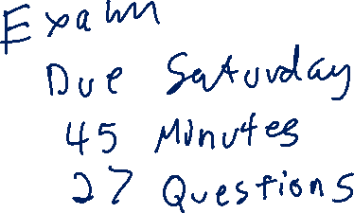
Stretch Break
Important Concepts:
Bandwidth
Packet-Switched Networks and Routers
IP Addresses
Network Protocols

Slide 22
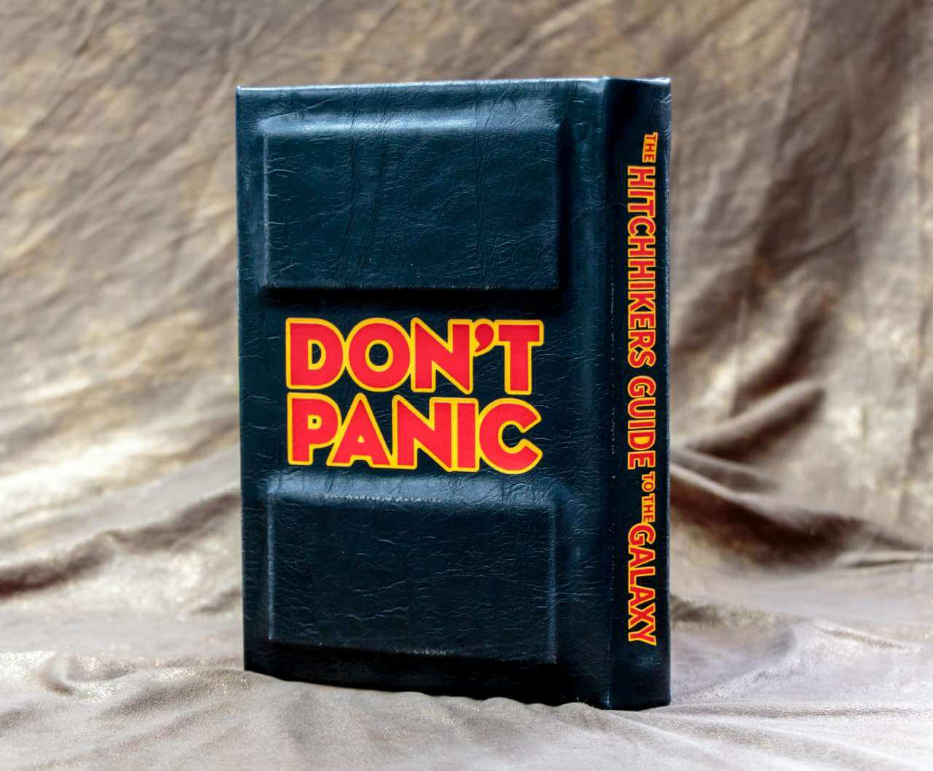

Slide 23
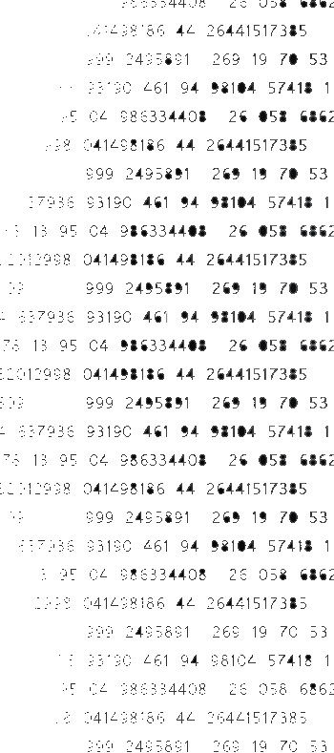
Information Security
Day 1
Notes:
Some threat detection maps below. No guarantee it is genuine data, but it does get a point across.
http://map.norsecorp.com
https://threatmap.checkpoint.com/ThreatPortal/livemap.html
https://cybermap.kaspersky.com/
http://www.digitalattackmap.com/#anim=1&color=0&country=ALL&list=0&time=17578&view=map

Slide 24
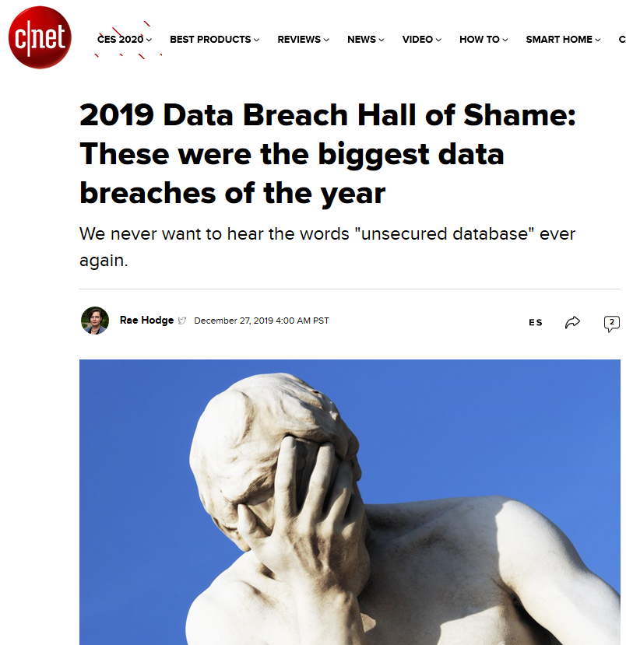
Typical cost of a breach: $3.92 million (IBM)
Firms: Marriott, Dubsmash, Facebook (multiple times), Instagram, First American Financial, Burger King, American Medical Collection Association, Capital One, MoviePass, Adobe.
Possibly the most serious: Capital One exposed 100 million credit card applications including social security numbers and detailed financial information.
https://www.cnet.com/news/2019-data-breach-hall-of-shame-these-were-the-biggest-data-breaches-of-the-year/

Slide 25

True or False: Only people with ‘highly valued’ information are at risk of becoming victim to costly security breaches?
False!
2013
Notes:
Target was hacked through a third party (HVAC) system that allowed hackers to plant malware in the POS system at target.

Slide 26
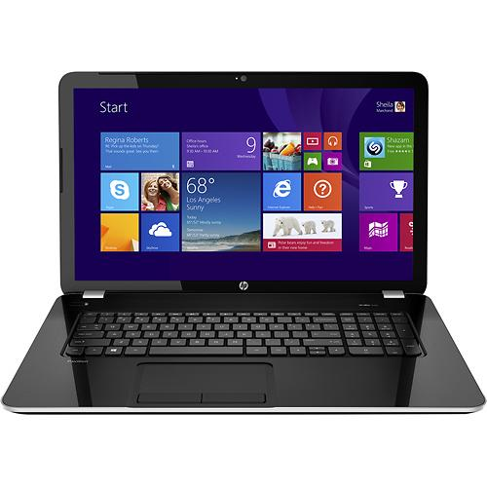
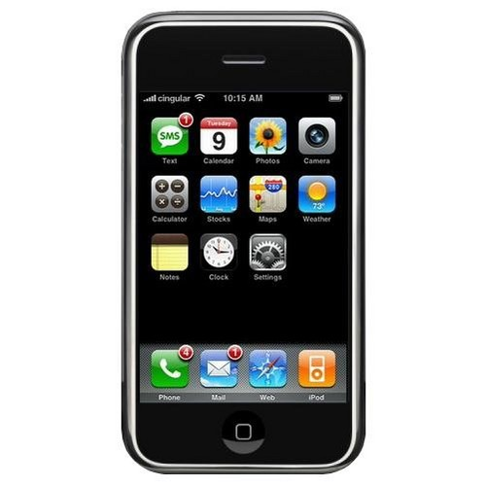
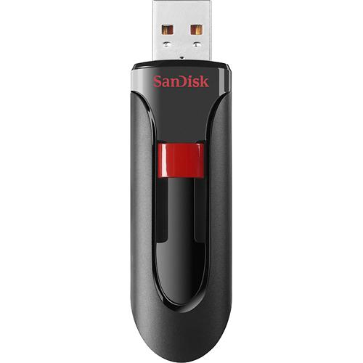
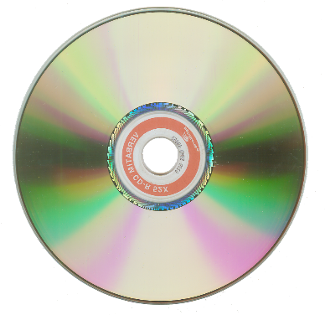
Threat: Lost and Stolen Hardware
Kali Hijack
Notes:
Optionally, do a demo of hacking into someone’s computer using Kali Pen Testing: http://www.kali.org/
Watch with mirroring360 on iPhone
Windows 10 makes this pretty tricky. Still possible, but you have to make change to the bios…

Slide 27
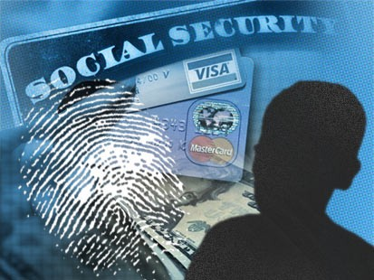
You Are at Risk! You have an identity
Financial Identity Theft
Medical Identity Theft
Criminal Identity Theft
Child Identity Theft
Notes:
Financial Identity Theft: stealing another person’s credit card or bank account number. This may also include using one’s identity (social security number, address, name, etc.) to apply for a credit card or loan that may impact credit ratings or cause unmerited financial obligations.
Medical Identity Theft: stealing another person’s personal information to obtain medical care, buy drugs, or submit fake billings to an insurance company. Aside from its financial consequences, it could be life threatening if wrong information is inserted into one’s medical records and wrong medical actions are taken based on these records.
Criminal Identity Theft: giving another person’s name, date of birth, driver’s license number, etc., to a law enforcement officer during an investigation or upon arrest. This may result in false criminal records, fines, or other illegal actions.
Child Identity Theft: stealing a minor’s social security number for personal gain. This type of fraud can go undetected for years, and it may not be discovered until a child’s later years (when applying for a driver’s license, a bank account, etc.).

Slide 28
You Are at Risk! You have connections
Use you to attack other people
Phishing messages
Spam (leveraging the trust you’ve built)
Malware
Notes:
RSA“The attack started with phishing emails sent to small groups of low-profile RSA users that ended up in the users' email junk folders”
“The emails were titled "2011 Recruitment Plan" and had a malicious Microsoft Excel spreadsheet attached”

Slide 29
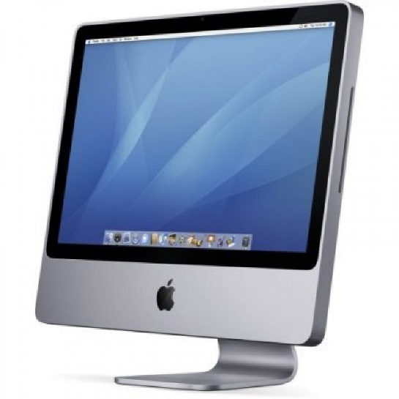
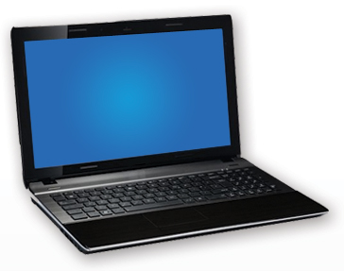
You Are at Risk! You have computing resources
Someone who gains access to your computer can:
Download or host illegal content/activity
Perform an attack on another entity
Spread malware
Do a Kali hijack

Slide 30
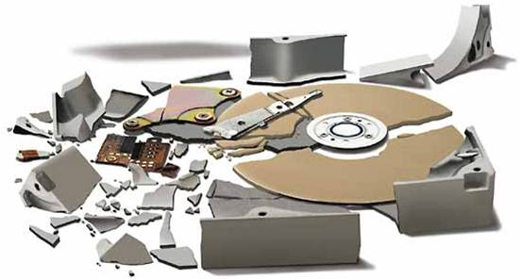
You Are at Risk! You have vulnerable hardware
Hardware failure
Average hard drive has a life span of approximately 3-5 years
At some point, you will lose your pictures, music, and other files if you don’t take precautions

Slide 31
Vocabulary
Information Security
The degree to which a system and its data are resistant to and protected from harm.
Security Breach
An incident that causes harm.
Remember: An information system includes people, data, computers and networks.

Slide 32

Who Causes a Security Threat?
The stereotype:
a dark room
secluded place
behind a computer
Lately: Russian, Chinese, Korean Hackers
“Some 400 pound guy”
Reality
Threats often look like normal people
You may know and trust them
Use social techniques in addition to technical techniques
False!

Slide 33
People Who Cause Security Threats
Non-Malicious Insider
Malicious Insider
“Hacker”

Slide 34
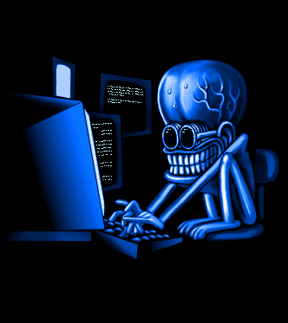
The Hacker
An outsider breaking into an organization
Different motivations:
Challenge
Monetary gain (identity theft)
Hactivists (wikileaks)
Cyberterrorists
Cyberwarfare
Offensive defense
How easy is it?
Notes:
Hactivists (hackers who are activists) promote political ends through breaking into computers or networks. They may deface a website (changing the appearance or content of a website) that is contrary to their opinion or make confidential information public to accomplish their political objective.
Cyberterrorists refer to hackers who use the internet to accomplish terrorist acts. Cyberterrorist acts may include disrupting or destroying an organization’s or nation’s infrastructure, such as disrupting a nation’s power supply or communication lines.
Closely related, cyberwarfare refers to nations or groups that conduct espionage or sabotage of another nation’s or organization’s information and infrastructure through hacking techniquespeople

Slide 35
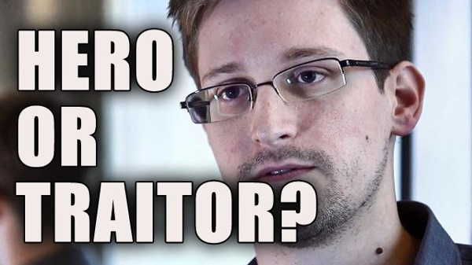
The Malicious Insider Threat
A legitimate and trusted member of an organization who compromises security
Often considered the most dangerous threat because they don’t have to break in
Edward Snowden

Slide 36
Penalties for cyber crimes
Minor: Fines up to $20,000, and/or jail time minimum of 6 months.
Major: Fines upward of $100,000 and jail time in excess of 20 years.

Slide 37
The Non-Malicious Insider Threat
An employee without malicious intent who compromises security through negligence or ignorance → YOU!
Clicking on links in phishing emails
Weak passwords
Are You an Insider Threat?
Visiting websites infected with malware
Losing thumb drives
Not backing up data
Leaving important papers out
Not locking computers
Sharing ‘sensitive’ information

Slide 38
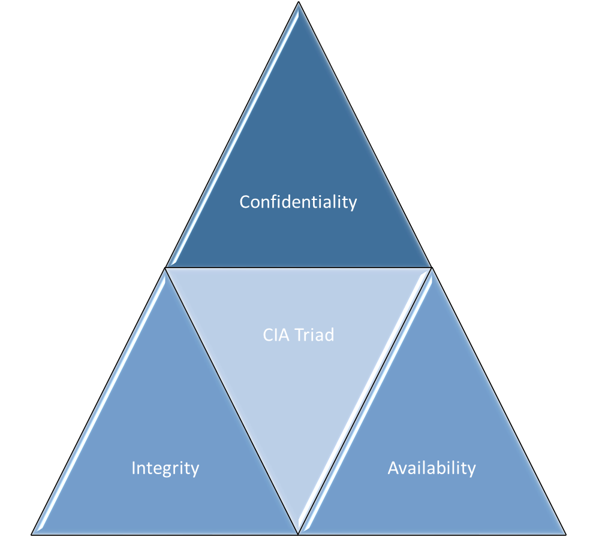
Security Threats and Counter Measures
Confidentiality
CIA Triad
Integrity
Availability
Notes:
Now we will talk about Security Threats and Countermeasures to These Threats. We will discuss them in three categories:
Confidentially
Availability
Integrity

Slide 39
Confidentiality
Restricting access to information and resources to only those who are authorized to use it

Slide 40

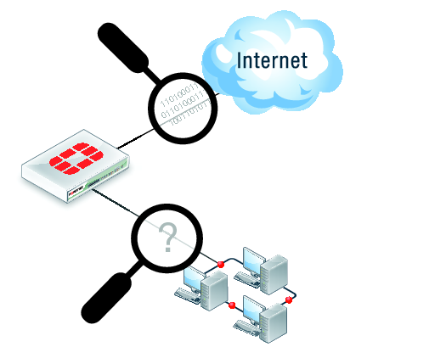
Threats to Confidentiality
Social Engineering (includes Phishing)
Network Sniffing
Password Guessing
Lost or Stolen Hardware

Slide 41
Protecting Yourself against Confidentiality Threats
Social Engineering
Awareness – Be Suspicious!
Network Sniffing
Make sure HTTPS encryption is on whenever you share sensitive information.
Use a VPN on public networks.
Password Guessing
Use good and different passwords – use a password manager.
Lost or Stolen Hardware
Encrypt all of your portable storage!

Slide 42
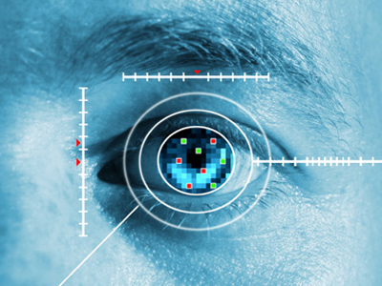
Authentication & Authorization
Authentication: verifying identity
Something-you-know
…password
Something-you-have
…keycard, ID badge
Something-you-are
…fingerprint, retina
Authorization: specifying access rights to users
Notes:
Something-you-have entails using an object (which you can carry with you) to authenticate. For example, in a non-digital setting, people carry keys to gain access to locked doors. Likewise, in a digital setting, objects can be used to gain access to systems. One such example is a smart card. A smart card (Figure 2) is a pocket-sized card that you can put in a slot on your computer or laptop. When you put this card in the slot, it automatically authenticates and gives you access to the information and resources you are authorized to use.
Often, something-you-have is used together with something-you-know to authenticate, in a process call dual-factor authentication. For example, in some organizations with sensitive information, you must enter your username and password along with a code that is on a token. Tokens (Figure 2) are small devices that you can carry with you which display a code every 30-60 seconds. The codes are synchronized with the system that will authenticate you. If the code on the token matches what you entered, you will be given access to the system assuming your password is also correct.
Something-you-are refers to using the physiological characteristics of a person to authenticate. For example, fingerprint scanners can be used to perform authentication. To gain access to a system, your fingerprint must match the fingerprint signature located on the authentication server. Other examples include:
Handprint readers
Retinal (eye) scanners
Vocalic (voice) characteristics
Keystroke timing
Once a person is authenticated (verified to be a legitimate user), a secure system should only allow that user to access the information and resources they are authorized to access. Authorization is the process of specifying access rights to users—i.e., specifying what users can and cannot access. For example, a sales person should be able to access information about clients and products. However, a sales person should probably not be able to access information about other employees’ salaries.

Slide 43
Protecting Yourself
Never give out sensitive information in an email
Be cautious clicking on links in an email.
Check where it is really going (hover over with mouse)
www.chasebank.con
Enable spam filter
Don't divulge too many personal details on craigslist.com, ksl.com, ebay.com, facebook marketplace, etc.
What can happen?
Too vocal on social media? “On vacation with fam for a week”

Slide 44
Threat: Network Sniffing
Intercepting packets on a network and viewing the contents of these packets
Unsecured wifi is vulnerable
Unencrypted data transfer (http)
DO NOT make purchases or check bank info while on open wifi
DO NOT make any transactions on http (https is okay)

Slide 45
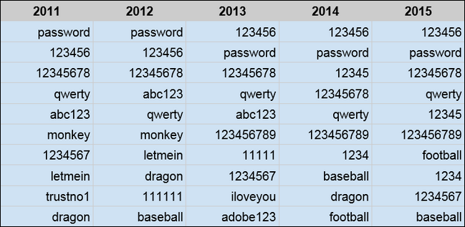
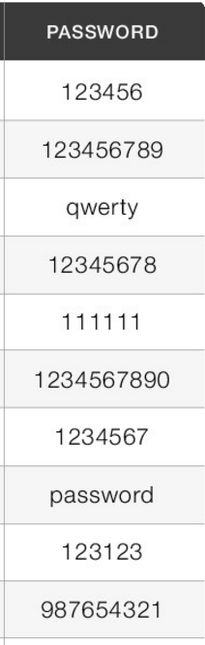
Threat: Password Guessing
2016
2017
123456
123456789
qwerty
12345678
111111
1234567890
1234567
password
123123
987654321
Password Security Checker
(Click Me)

Slide 46

How Can Someone get your Password?
Gathering personal information about you
Password reuse
Dictionary attacks and brute force attacks (32 million accounts in the RockYou dictionary)
Password reuse is often described as a ‘Domino Effect’—after the failure of the weakest system, other systems will follow, yielding new password information from which still more systems will fail

Slide 47
Password complexity
Compare the following passwords:
homer
Homerjs1
@#4Tj`9q
purplemonkeydishwater
How easy to remember?
How easy to type?
How secure?
CharacterBase^{Length}
26¹² = 95,428,956,661,682,176 possible combinations
95⁸ = 6,634,204,312,890,625 possible combinations
The typical password ratings on websites focus on mixed case, numbers, and symbols. This is poor guidance.

Slide 48
Password Complexity
Type | Typo Failures | Memory Failures | Security
Simple passwords (homer) | 2.11% | 18.22% | 20/20 cracked
Passwords w/requirements (Homerjs1) | 4.12% | 20.17% | 18/20 cracked
Random passwords (@#4Tj`9q) | 5.36% | 24.78% | 2/20 cracked
Passphrases (purplemonkeydishwater) | 2.34% | 7.80% | 0/20 cracked

Slide 49
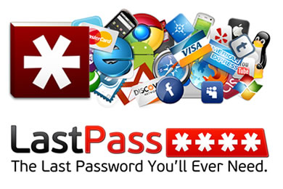


Password Management Software
Password123

Slide 50
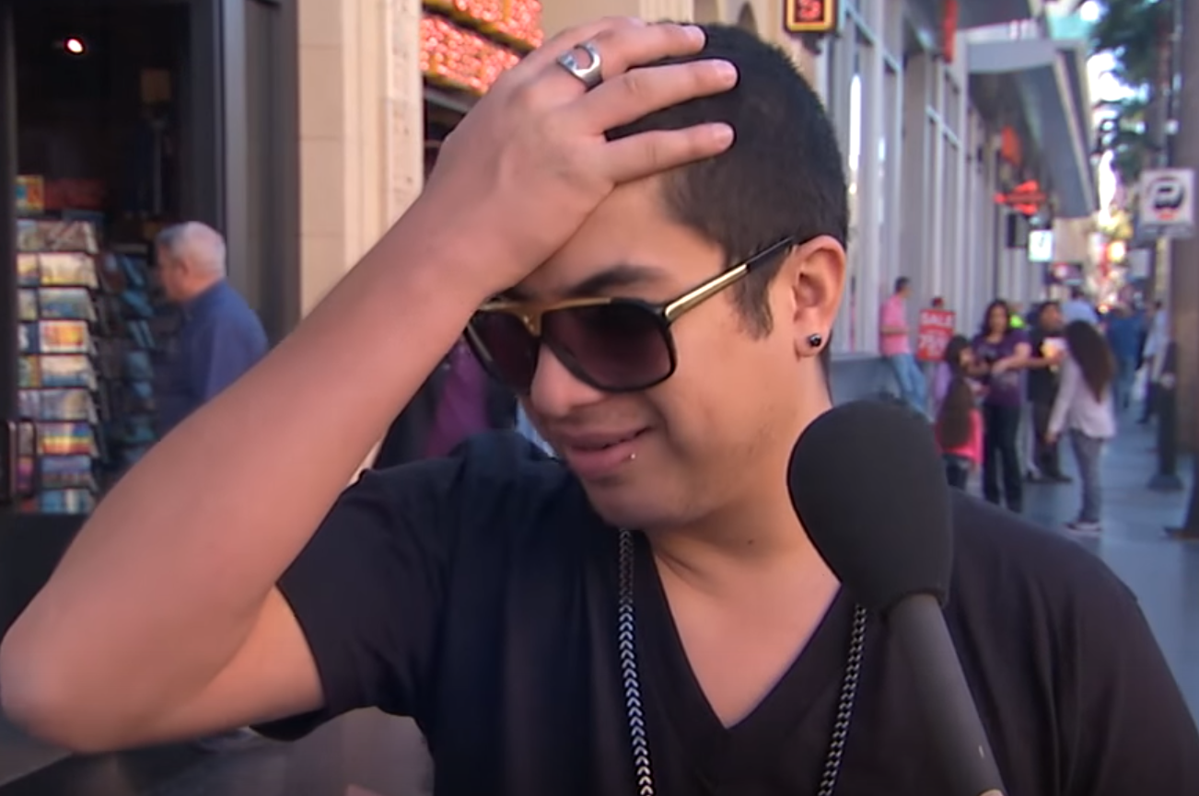
Protecting Yourself
Don’t put anything important unencrypted on a portable device
Put a password on your cell phone, because if someone takes your cell phone, they have access to:
all of your personal information
your accounts
your credit card (e.g., Google Wallet)
your location (where you go during the day, if you go to church, where you work, etc.)
Don’t use thumb drive you found laying around
Don’t be an idiot →
Notes:
Video of stealing passwords

Slide 51
Protecting yourself
Laptops and mobile devices
Select an operating system that facilitates secure logins
Encrypt your drives (Built into Windows 10 and MacOS)
Mark or engrave the computer’s case
Use fingerprint readers
Use geo-tracking software

Slide 52
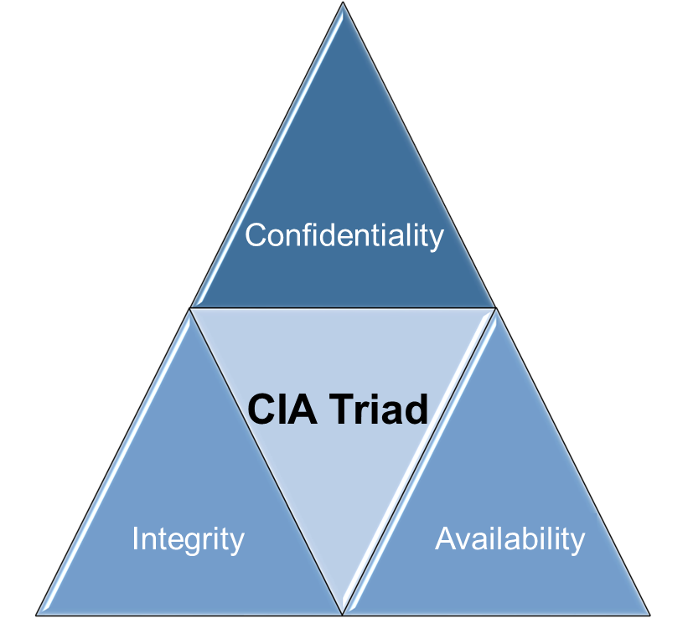
Availability
Ensuring that authorized users are able to access information and resources when they need it

Slide 53

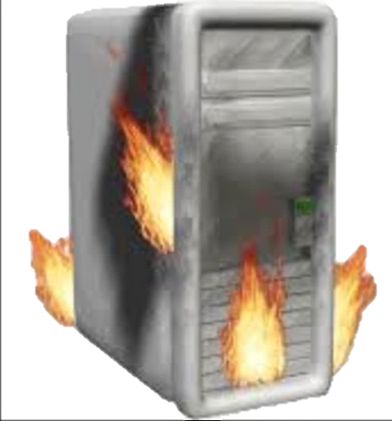

Downtime
$8.8 Billion in 2019
Downtime – a period of time when a system is unavailable
2013-2016
Issue | Cost
Annual IS downtime costs just in North America | $700 billion
% drop in revenue during outage | 29%
% drop in revenue for a whole business day | 17%
Cost per hour of outage | $90,000 - $6.48 million
Cost per minute | $1500 - $108,000
Cost per second | $25 - $1800
Average cost per incident | $740,000
% of downtime due to cybercrime | 22%
http://www.emersonnetworkpower.com/en-US/About/NewsRoom/NewsReleases/Pages/Emerson-Network-Power-Study-Says-Unplanned-Data-Center-Outages-Cost-Companies-Nearly-9000-Per-Minute-.aspx
http://www.networkcomputing.com/networking/high-price-it-downtime/856595126
Notes:
In 2017, Delta had a server fire that ended up costing $150 million, plus brand damage.
Marriott systems went down and they lost approximately 8.8 billion due to lost sales, refunds, and loyalty

Slide 54
Threats to Availability
Forgotten Credentials – the most common help desk call of all time.
Hardware Failure
Physical Attacks or Theft
Denial of Service (including DDoS)
Malware

Slide 55
Protecting Against Threats to Availability
Forgotten Credentials
Use good passwords and a password manager.
Hardware Failure
Online Backups: OneDrive, iCloud, Google Drive, etc.
Physical Security (Deliberate and Natural)
Locks, Location, Co-Location
Backup Power, Redundant Networking Infrastructure
Denial of Service (including DDoS)
Firewalls, work with your Internet Service Provider
Malware
Awareness
Virus Scanner: Built into Windows and MacOs

Slide 56

Threat: Hardware Failure
Conventional wisdom: reliable life span of a hard drive is 3-5 years
At some point, you will inevitably lose something!
Depending on how you use the hard drive, SSD will usually outlast HDD

Slide 57
Threat: Physical Security
The security of the physical infrastructure and hardware against physical threats.
Threats:
Fire
Water
Vibration and movement (earthquakes, landslides, explosions)
Severe weather (hurricanes, tornadoes, high winds, severe lightening, etc)
Electrostatic discharge
high humidity causes corrosion, low humidity causes ESD
Electrical noise (EMI and RFI interference)
Electrical anomalies (blackout, brownout, fault, spike, sag, surge, inrush)
Lightning strikes
Magnetic fields (Solar Flare)
Sabotage/terrorism/war/theft/vandalism
Equipment failure
Loss of communications and utilities
Personnel loss
Natural
Elements
Electrical
Other

Slide 58
Physical Security
Data center tiers
Tier | Requirements
1 | Single non-redundant distribution path serving the IT equipment Non-redundant capacity components Basic site infrastructure guaranteeing 99.671% availability (could be down 29 hours per year)
2 | Meets or exceeds all Tier 1 requirements Redundant site infrastructure capacity components guaranteeing 99.741% availability
3 | Meets or exceeds all Tier 1 and Tier 2 requirements Multiple independent distribution paths serving the IT equipment All IT equipment must be dual-powered and fully compatible with the topology of a site's architecture Concurrently maintainable site infrastructure guaranteeing 99.982% availability
4 | Meets or exceeds all Tier 1, Tier 2 and Tier 3 requirements All cooling equipment is independently dual-powered, including chillers and heating, ventilating and air-conditioning (HVAC) systems Fault-tolerant site infrastructure with electrical power storage and distribution facilities guaranteeing 99.995% availability (could be down 27 minutes per year)
http://en.wikipedia.org/wiki/Data_center#Data_center_tiers
Notes:
Mostly just FYI. Not on the exam.

Slide 59
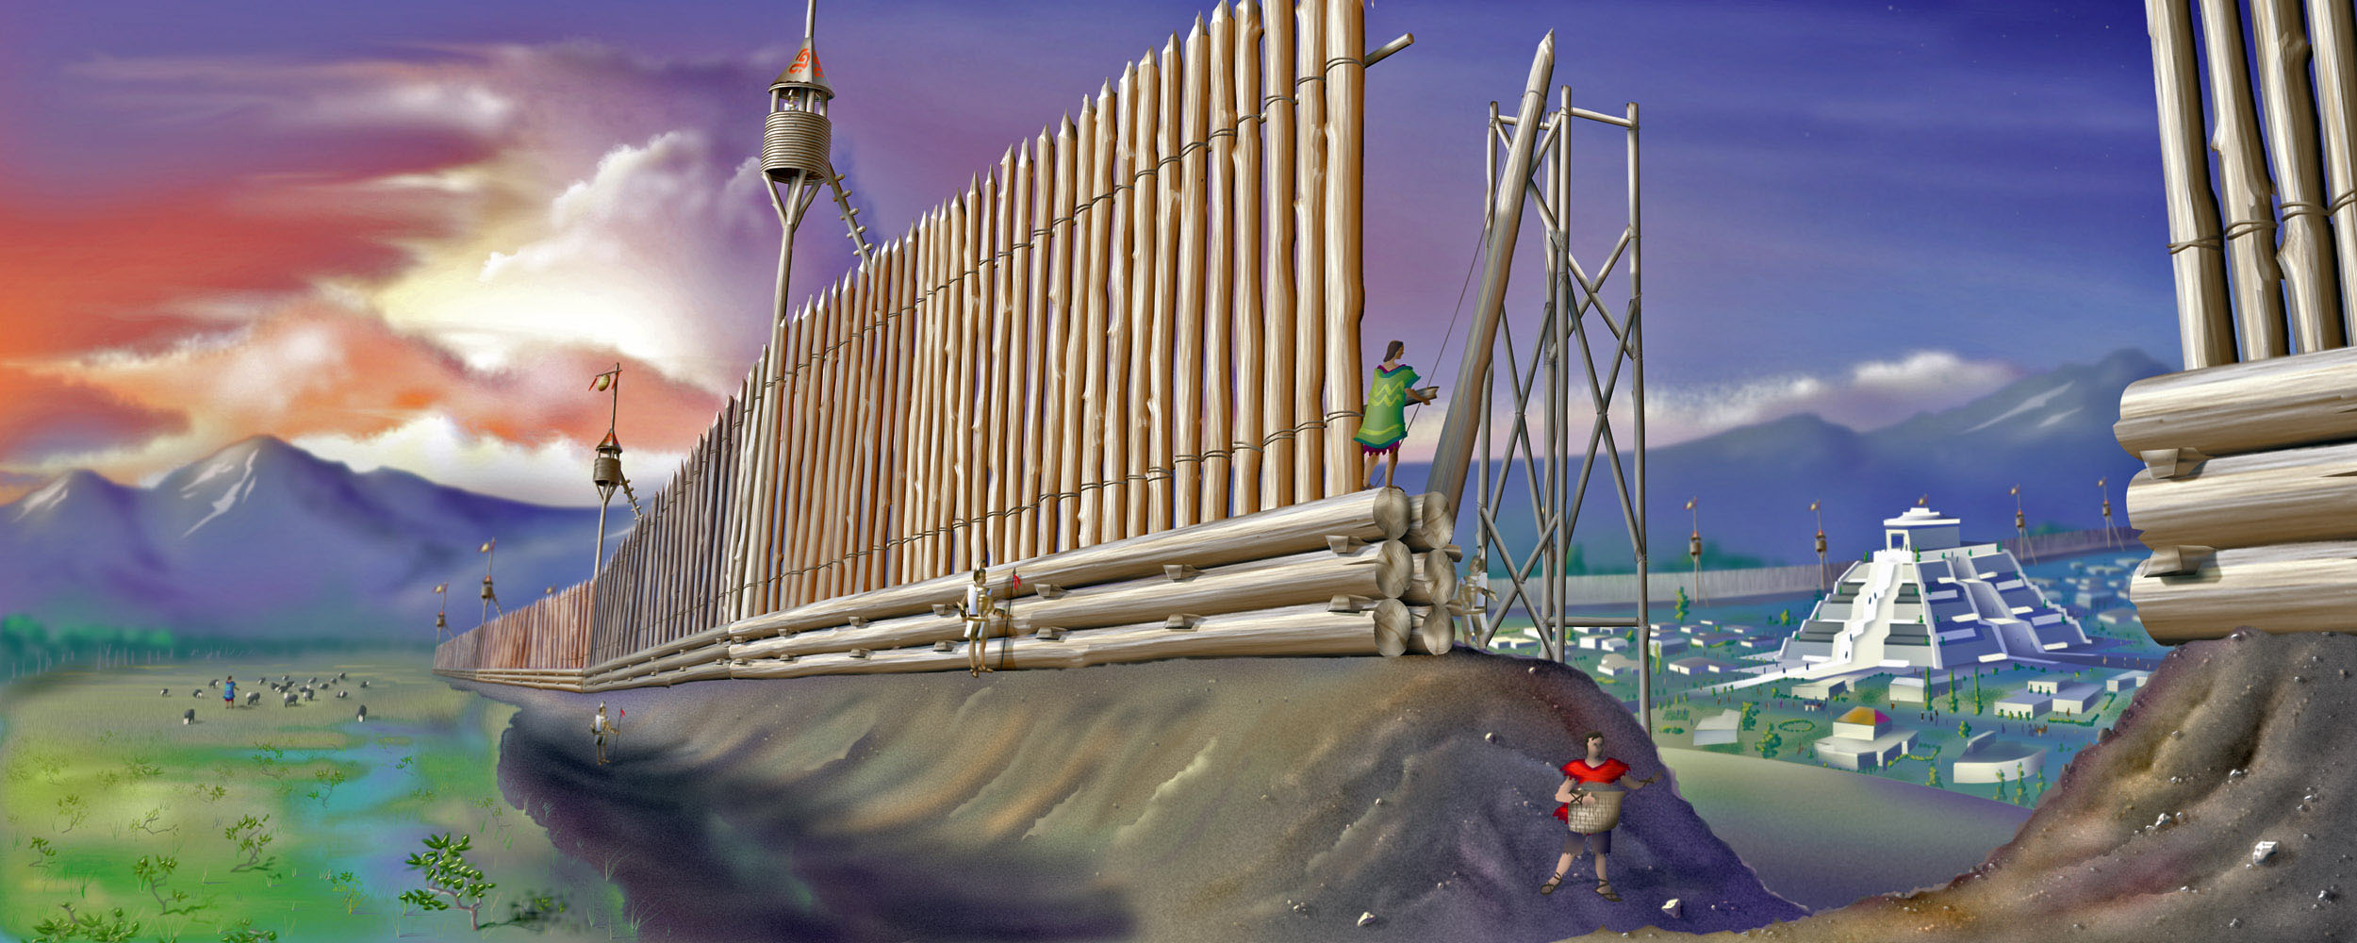
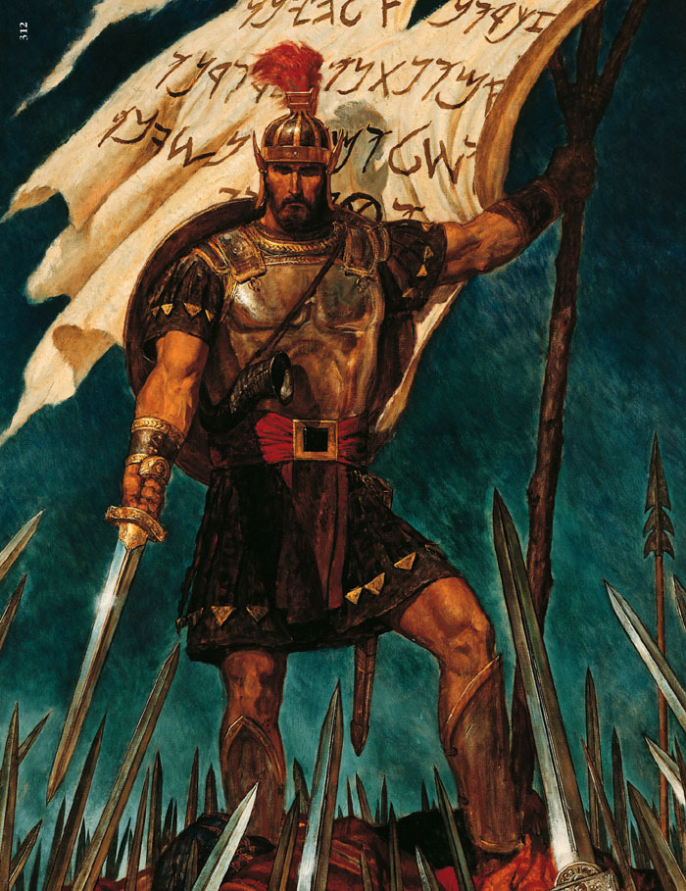
7 Now it came to pass that while Amalickiah had thus been obtaining power by fraud and deceit, Moroni, on the other hand, had been preparing the minds of the people to be faithful unto the Lord their God.
8 Yea, he had been strengthening the armies of the Nephites, and erecting small forts, or places of resort; throwing up banks of earth round about to enclose his armies, and also building walls of stone to encircle them about, round about their cities and the borders of their lands; yea, all round about the land.
9 And in their weakest fortifications he did place the greater number of men; and thus he did fortify and strengthen the land which was possessed by the Nephites.
10 And thus he was preparing to support their liberty, their lands, their wives, and their children, and their peace, and that they might live unto the Lord their God, and that they might maintain that which was called by their enemies the cause of Christians.
Alma 48
Notes:
Where would you put your servers?

Slide 60
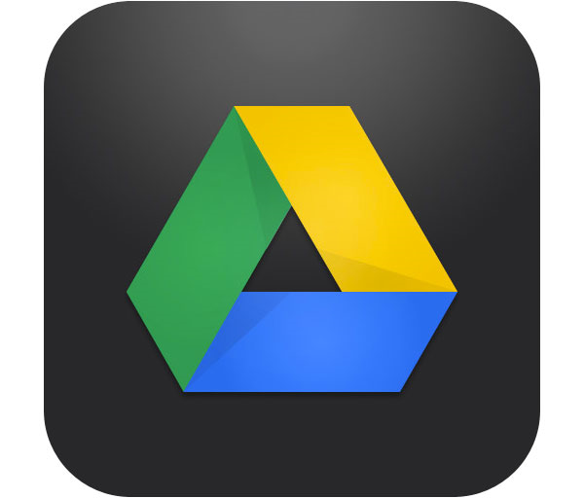
Protecting Yourself
Redundancy (i.e., backup)
Considerations:
Where to back up your data (onsite vs. offsite)
How frequently to backup your data (timed vs. continuous)
Version control
What data to backup (entire system vs. selected files)
How do you secure your data
Notes:
Google drive IS 201 Fail. Nearly every semester, the entire google drive folder gets wiped by accident.

Slide 61
Threat: Malware
A malicious program that may…
Occupy the resources of your computer
Making it slow or nonresponsive
Cause damage to your computer
Take control of your computer
Steal info from your computer

Slide 62
Virus
Attaches to legitimate files or applications
Spreads as people share these files or applications
Malware
Worm
Self-replicates
Does not require people to share infected files
Trojan Horse
Disguised as a legitimate program
Does not self-replicate or infect files
Notes:
A virus refers to a malicious program that attaches itself to another program or file. It spreads from one computer to another as users share programs or files with each other. A worm is similar to a virus, except that it can spread from computer to computer by itself (without requiring users to share the virus). Finally, a Trojan horse is a malicious program that is disguised to be a legitimate, useful program. However, when you open the Trojan horse, it may consume the resources of your computer, cause damage to your computer (e.g., delete files), steal information, or create a backdoor that allows someone to take control of your computer. Trojan horses do not self-replicate or infect files like worms or viruses respectively do (see Figure 6 for a comparison and contrast of viruses, worms, and Trojan horses).

Slide 63
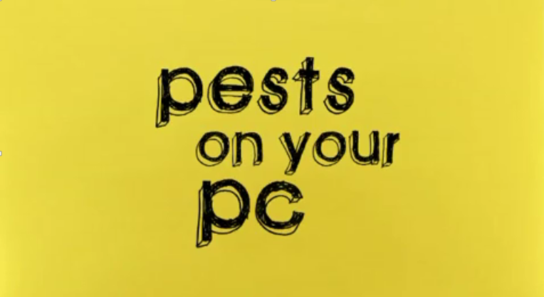
Viruses, Worms, and Trojan Horses…oh my
Video: Some of the worst
Notes:
Yellow: 2:38
Purple: 9:00+ (probably won’t get to this)

Slide 64
Protecting Yourself
Have updated antivirus protection
Do not click on unknown attachments
Turn on firewall
Keep patches up to date
Do not visit ‘shady’ websites, or click on unknown links in emails.
Be hesitant putting other people’s thumb drives in your computer.

Slide 65
Threat: Denial-of-Service Attack
A distributed denial-of-service attack: a coordinated effort to flood a system (e.g., a website) with traffic
Practical example. Don’t try this at home folks.
IOT Hub shutdown of 2016
Notes:
The practical example could be an Excel VBA loop attack on some website. E.g., stick the following in a loop in excel: Call Shell("ping -t -l 32 https://altright.com/")
In 2016, the entire internet in the US failed because of a DDOS originating from IOT devices (which tend to be poorly secured). These billions of devices all pinged central hubs in New England simultaneously. The Hub had to shut down due to overload. That hub is the one that google, facebook, Amazon, and most other large online services route through.

Slide 66
Protecting Yourself
One of the most common defenses for preventing a denial-of-service attack (along with many other security breaches) is a firewall
Firewall – hardware and/or software that guards a private network by analyzing the information leaving and entering the network and then blocks unauthorized or suspicious content
But: A firewall cannot protect you from a Distributed denial of service attack (DDoS). For that you must work with your Internet Service Provider.

Slide 67
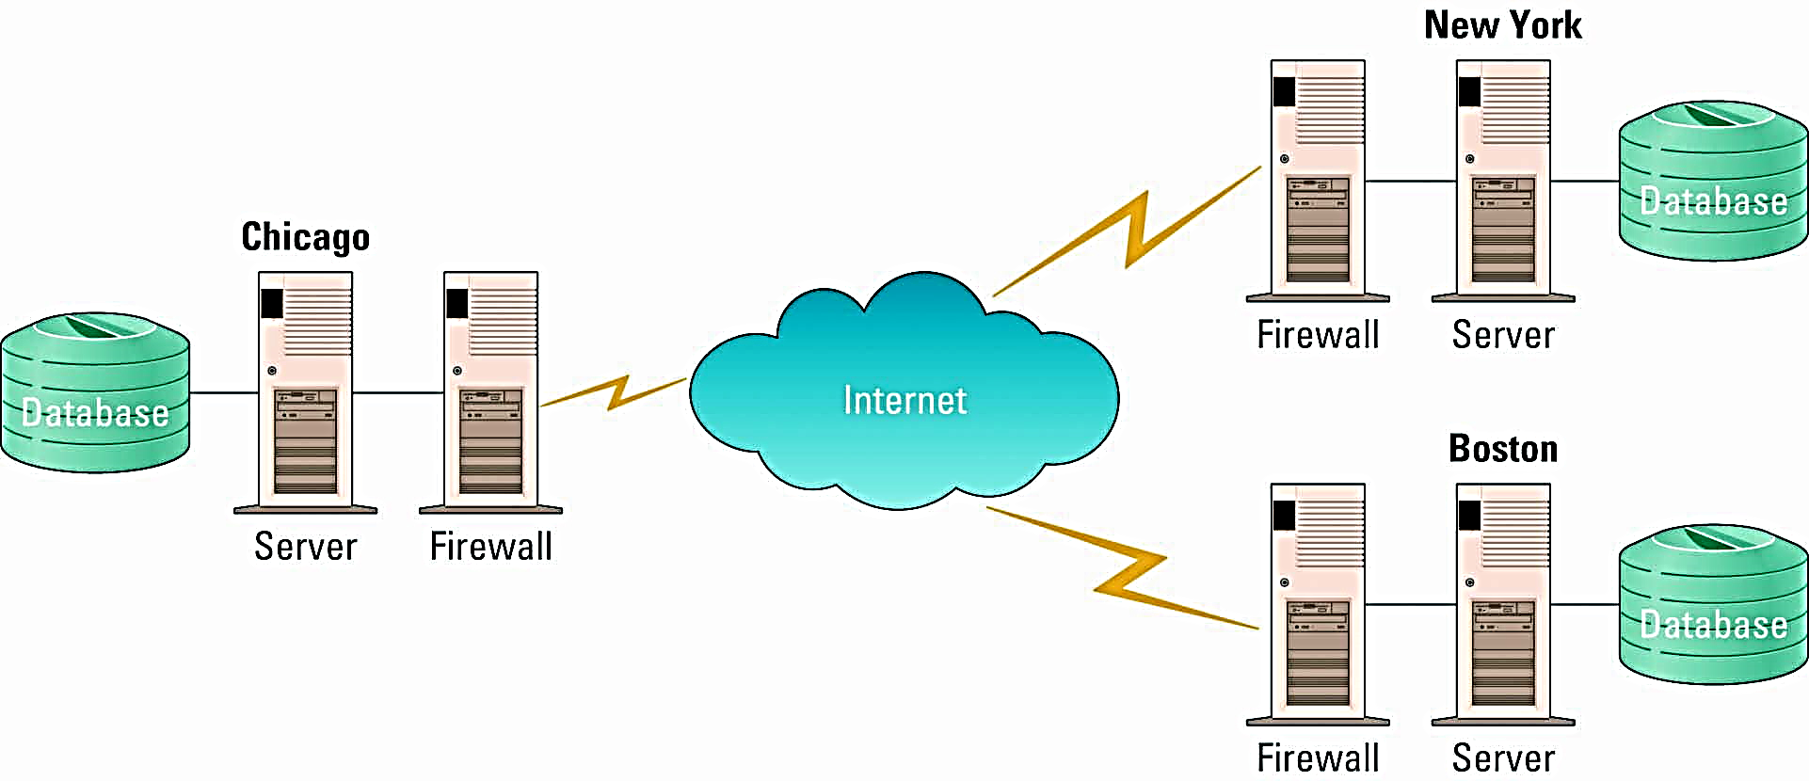
Firewalls
Sample firewall architecture connecting systems located in Chicago, New York, and Boston
Internet

Slide 68
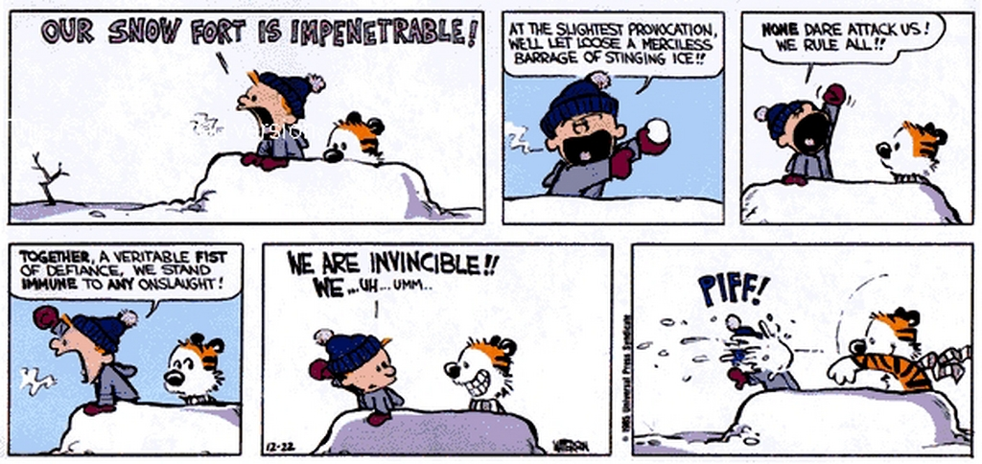
Perimeter vs Pervasive Security
Malicious Insider!

Slide 69
Integrity
Protecting data from unauthorized modification or deletion
Confidentiality
CIA Triad
Integrity
Availability

Slide 70
Threats to Integrity
Accidental Deletion
Incorrect Changes

Slide 71
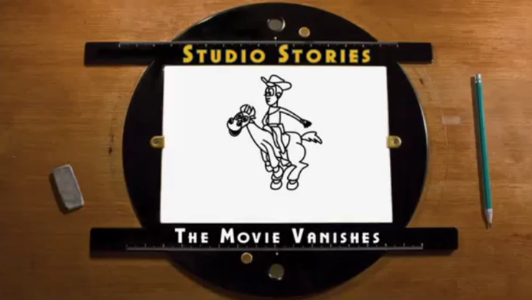
#1 Cause of Data Loss: Accidental Deletion
Notes:
Click to watch

Slide 72
Protecting Against Threats to Integrity
Access Control
The Authorization part of Authentication and Authorization
Backups
Off-site whenever possible
Version Control
Keeps multiple versions of each document.

Slide 73
Putting It All Together: Defense-in-Depth
Having multiple layers of security
If you had a valuable object, how would you protect it?

Slide 74
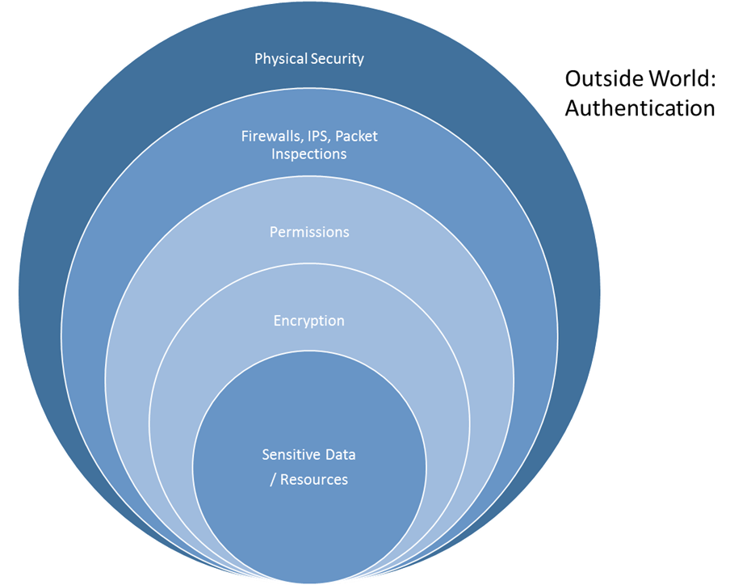
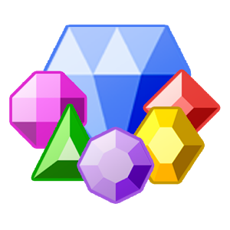
Onion Model
Notes:
IPS=Intrusion Protection System

Slide 75
Fill out the survey!
Learning Suite – Content – Polls – “How was class today?”
This Concludes Lectures for Chapter 2
Quiz on 2.3 and 2.4 due by 11:59 Today
Exam due by 11:59 Saturday
Coming Up
Chapter 3: Data Storage and Extraction (Databases)
Marks a transition from knowledge-based to skills-based learning

Slide 76
Optional Appendix: Ethical Hacking

Slide 77
How to Ethically Hack
Get permission in writing to perform your tests.
Set goals and develop a plan before you get started.
Have access to the right tools for the tasks at hand.
Test at a time that's best for the business.
Keep the key players in the loop during your testing.
Understand that it's not possible to detect every security vulnerability.
Study malicious hacker and rogue insider behaviors and tactics.
Don't overlook nontechnical security issues; they're often exploited first.
Make sure that all your testing is aboveboard.
Treat other people's confidential information at least as well as you would treat your own.
Bring vulnerabilities you find to the attention of management and implement the appropriate countermeasures.
Don't treat every vulnerability discovered in the same manner.
Not all weaknesses are bad. Evaluate the context of the issues found before you declare that the sky is falling.

Slide 78
“Ethical” Hacking Tools
You need to know how susceptible your IT systems are. Therefore, you need to understand the tools hackers use and use them yourself on your own system
Password cracking software
ophcrack and Proactive Password Auditor
Network scanning software,
SuperScan and Nmap
Network vulnerability scanner
LANguard and QualysGuard
Network analyzer software
OmniPeek and AirMagnet WiFi Analyzer
File search software
FileLocator Pro and Identity Finder Professional
Web application vulnerability scanner
Acunetix Web Vulnerability Scanner and WebInspect
Database security scanner
SQLPing3 and AppDetectivePro
Exploit software
Metasploit and Nessus

Slide 79
Tools/Resources for Ethical Hacking
Brutus (remote password cracker)
Cain & Abel (“password recovery” tool)
GFI LANguard (network security and vulnerability scanner)
Google Hacking Database (Web application resource)
Metasploit (multiuse exploit scanner)
Nessus (multiuse vulnerability scanner)
NetStumbler (wireless network tool)
OmniPeek (wireless network tool)
ophcrack (password cracking tool)
QualysGuard (Windows tool)
RainbowCrack (password cracking tool)
SecureIIS (system hardening tool)
Wireless Vulnerabilities and Exploits (wireless network tool)

